Slide 1
Springschool 2023
Prof. Dr. Julian Keil
Biologische Psychologie | Christian-Albrechts-Universität Kiel
www.biopsych.uni-kiel.de | keil@psychologie.uni-kiel.de | @drjuliankeil

Slide 2

Oscillations
https://www.youtube.com/watch?v=Au5tGPPcPus
Prof. Dr. Julian Keil | keil@psychologie.uni-kiel.de | www.biopsych.uni-kiel.de
Notes:
Frage an Studis: What are Oscillations? What things oscillate?
Synchronizing Metronomes

Slide 3
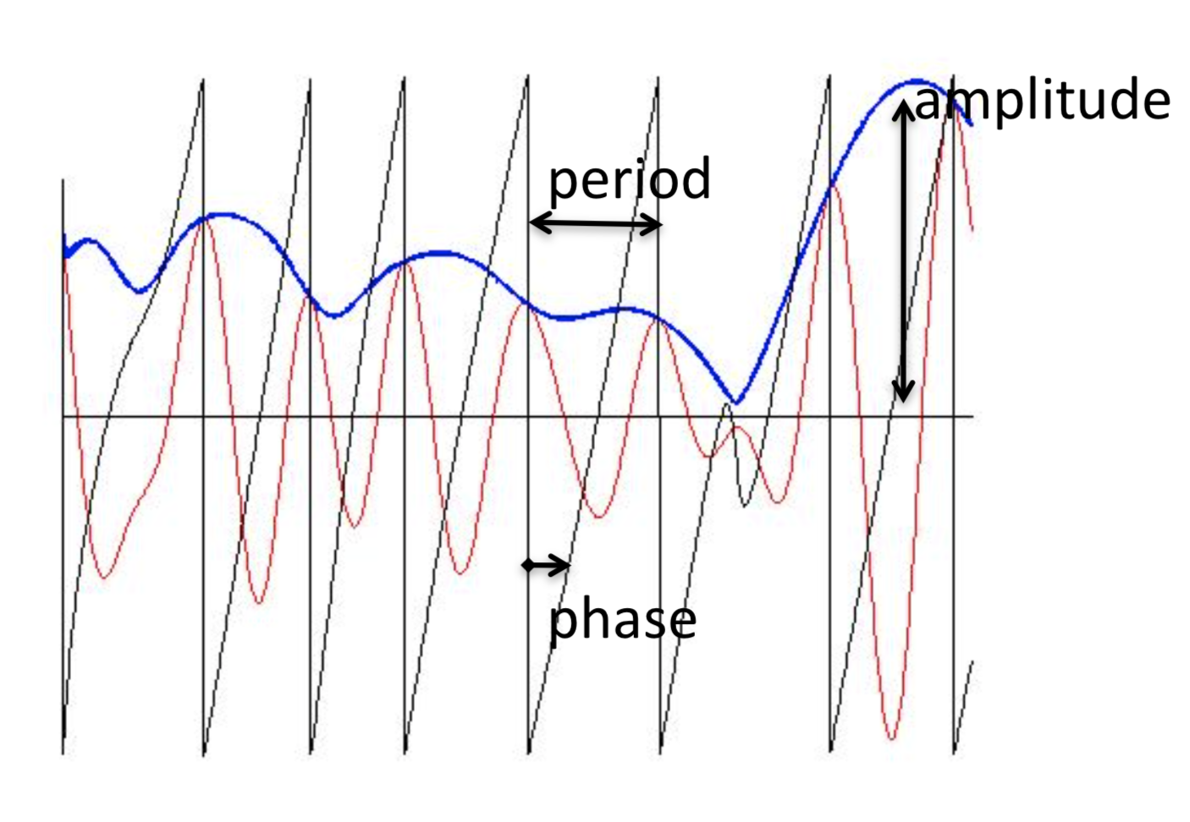
Oscillations
Prof. Dr. Julian Keil | keil@psychologie.uni-kiel.de | www.biopsych.uni-kiel.de
Notes:
Different aspects of neural oscillations
ERP: Phase always similar, only amplitude varies
Time-Frequency Analysis: All aspects can vary

Slide 4
Overview
Structure of the neocortex
How is information transported?
How can we record signals from the neocortex?
Role of neural oscillations for cognition
Prof. Dr. Julian Keil | keil@psychologie.uni-kiel.de | www.biopsych.uni-kiel.de

Slide 5
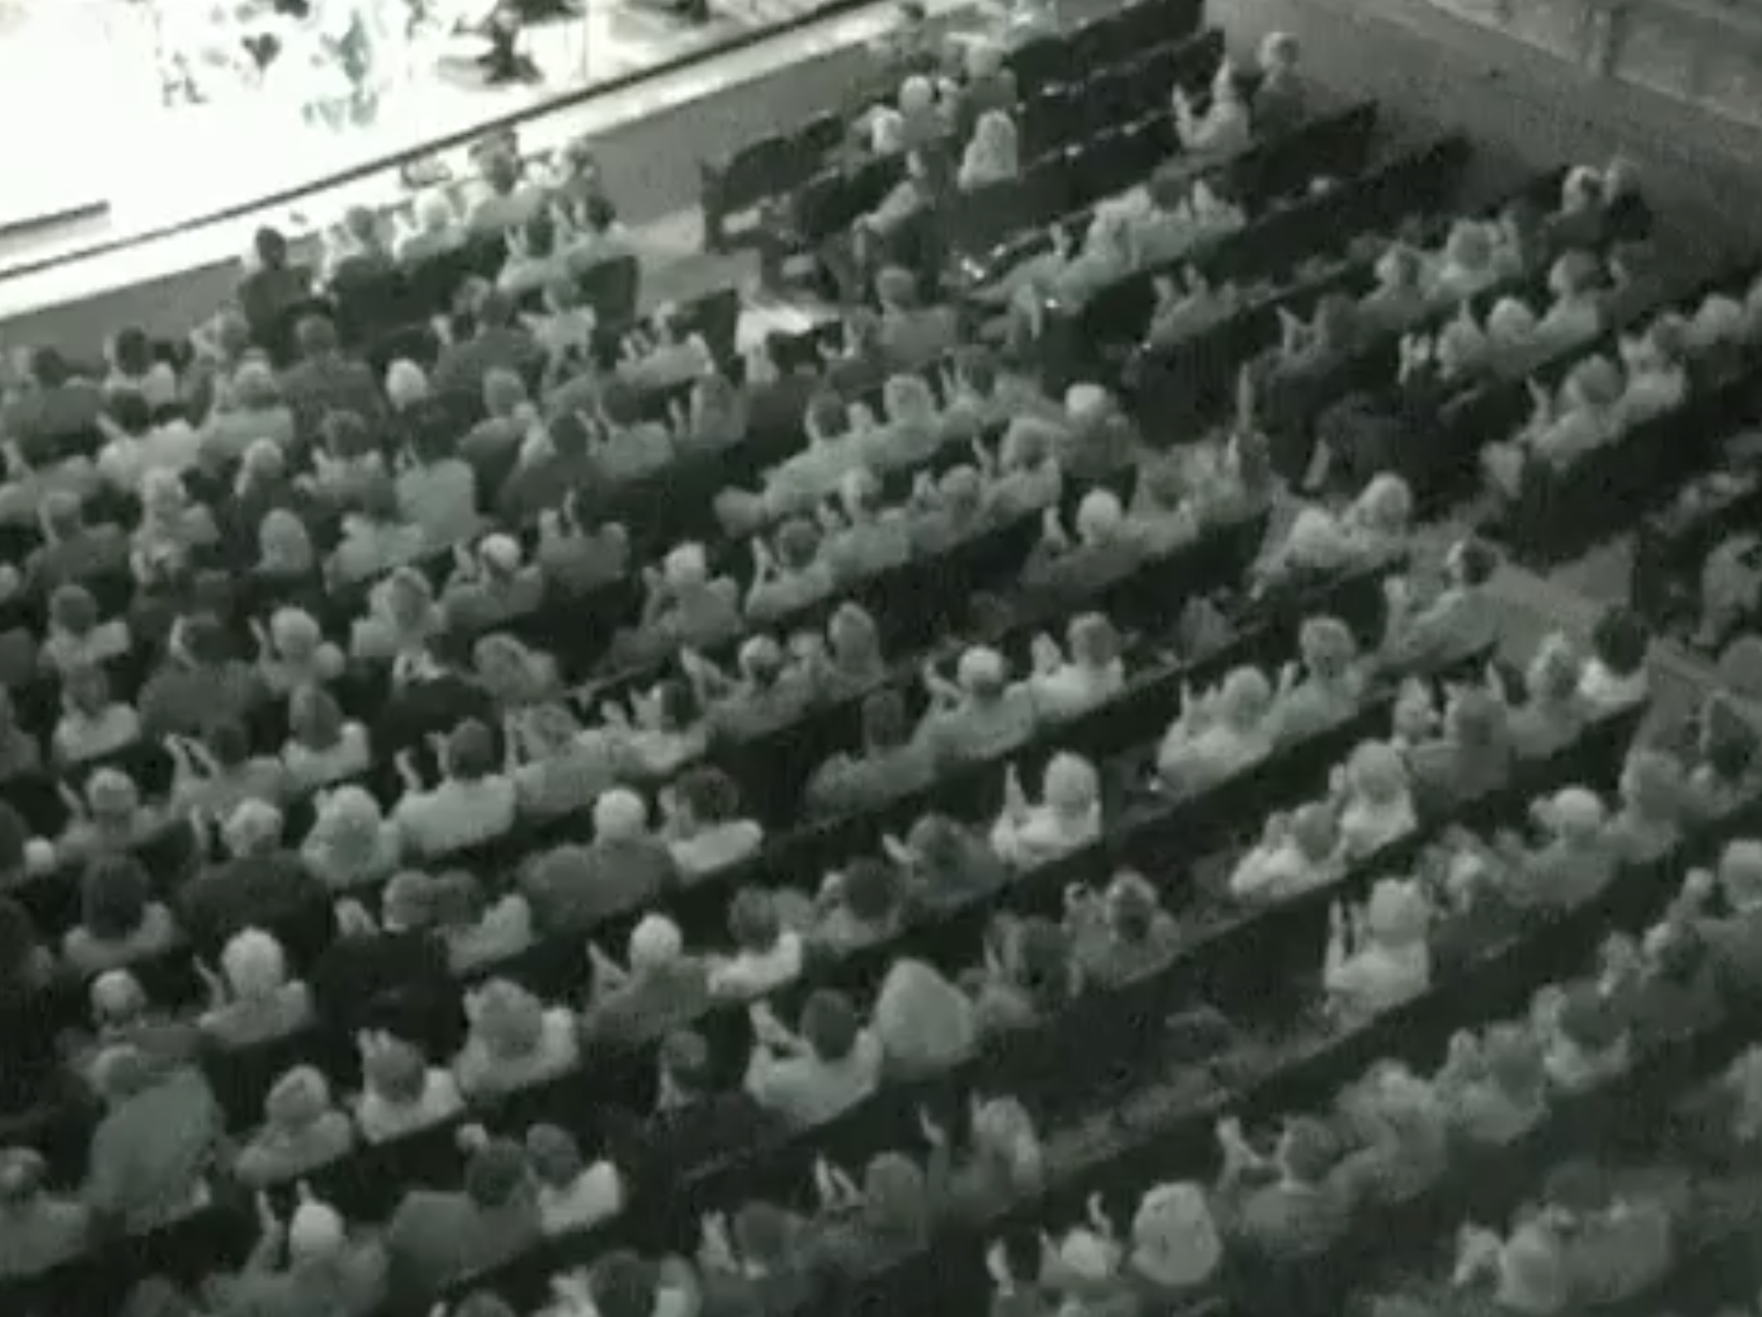
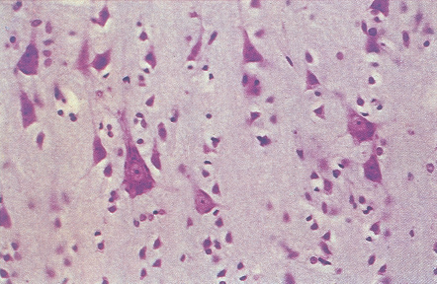
Anatomy
https://www.youtube.com/watch?v=Aaxw4zbULMs
Prof. Dr. Julian Keil | keil@psychologie.uni-kiel.de | www.biopsych.uni-kiel.de
Notes:
Demo Clapping Example
-> Rhythmic Behavior emerges from noise -> Lateral inhibition
-> In a crowd, all elements are connected (seeing, hearing, being friends, social media), in our brain the elements (neurons) are also strongly interconnected.
Multiple Elements encode Stimulus: Crowd „encodes“ Start or End of a Concert, Neurons encode Stimuli.
Just as we record the action of a crowd using microphones, we can record the action of neurons from far away.

Slide 6
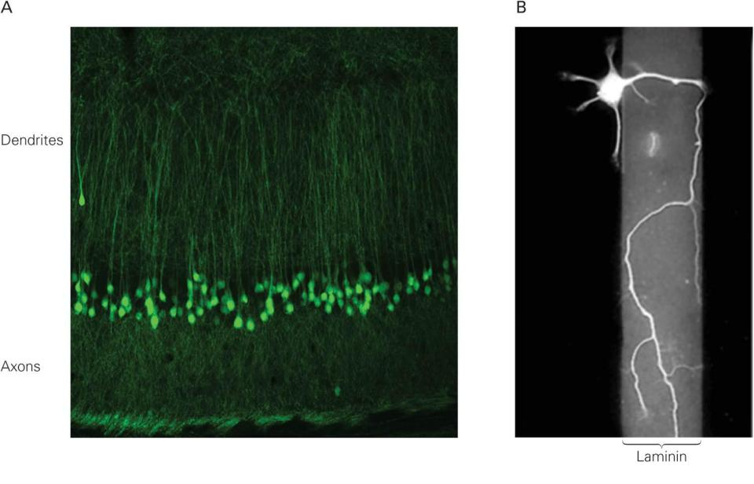
Structure of the neocortex
Prof. Dr. Julian Keil | keil@psychologie.uni-kiel.de | www.biopsych.uni-kiel.de
Notes:
The neocortex is made up of (usually) 6 layers of pyramidal neurons, and a lot of other supporting cells (glia cells, interneurons etc.).

Slide 7
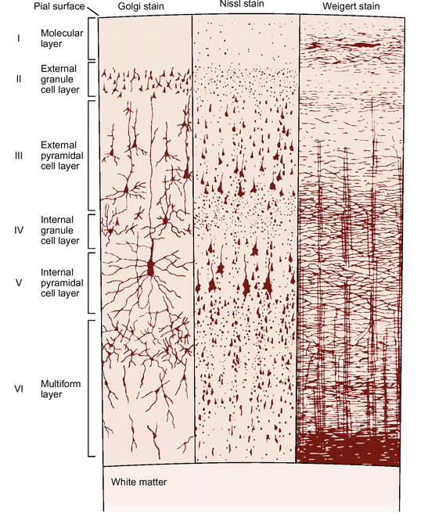
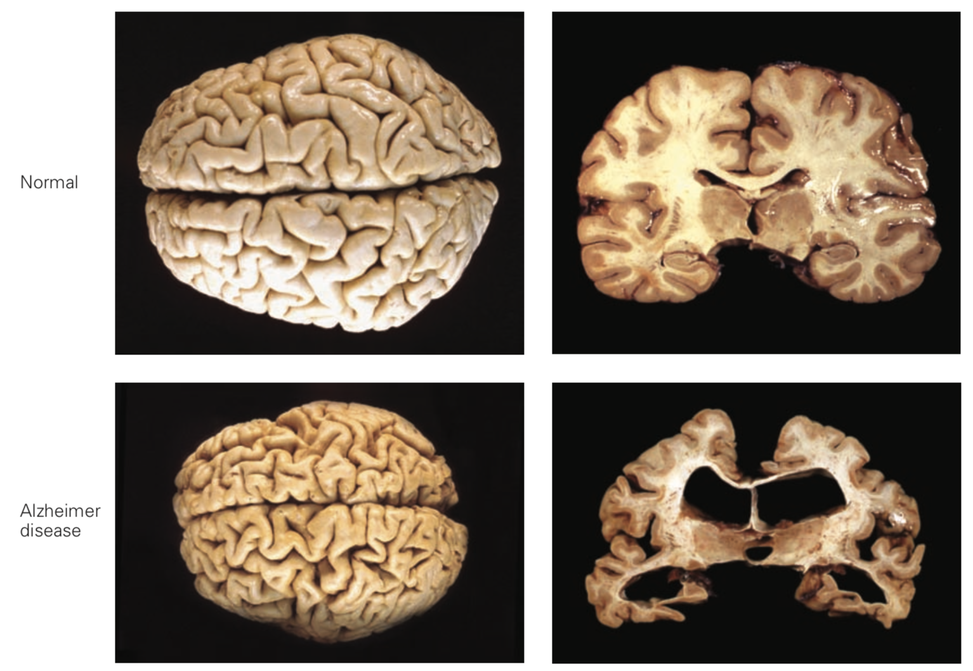
Structure of the neocortex
Prof. Dr. Julian Keil | keil@psychologie.uni-kiel.de | www.biopsych.uni-kiel.de
Notes:
The neocortex is made up of (usually) 6 layers of pyramidal neurons, and a lot of other supporting cells (glia cells, interneurons etc.).

Slide 8
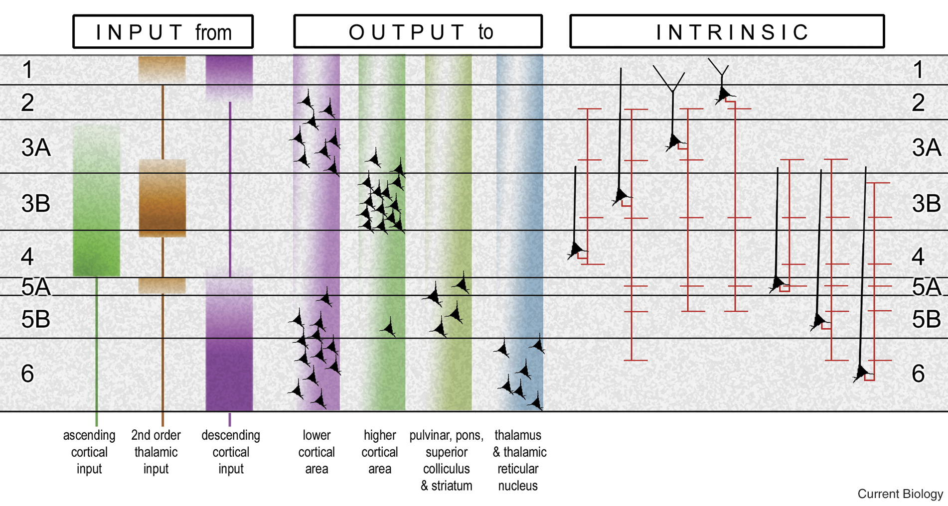
Structure of the neocortex
Prof. Dr. Julian Keil | keil@psychologie.uni-kiel.de | www.biopsych.uni-kiel.de
Notes:
Different Layers have different tasks. Ascending input (e.g. Visual or auditory information) arrives in layers 3 & 4,Thalamic input arrives in layers 3 and 5, Cortico-Cortical connections in layers 1 and 6.

Slide 9
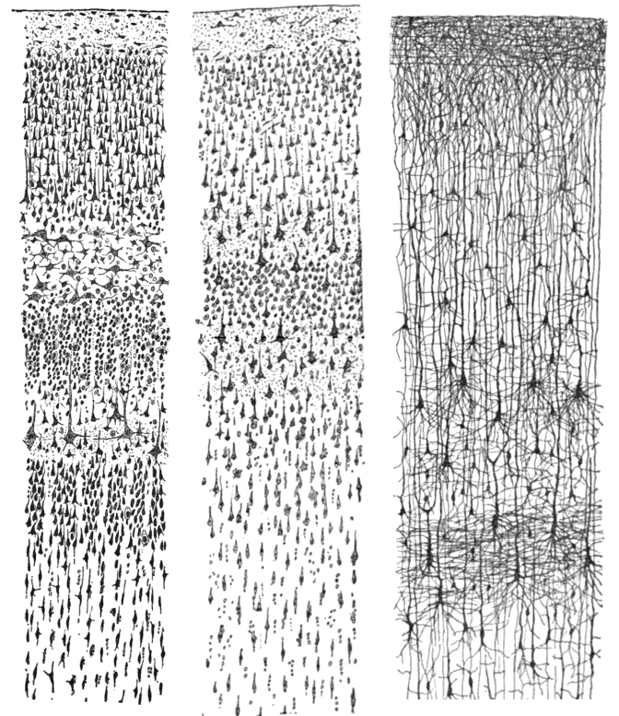
Interim Summary: Structure of the Neocortex
Gray matter consists of (usually) 6 layers of neurons
Different layers serve different purposes
White matter consists of axon fiber bundles
Prof. Dr. Julian Keil | keil@psychologie.uni-kiel.de | www.biopsych.uni-kiel.de
Notes:
Frage an Studis: Neurons communicate, but how? What Processes are relevant to get Information from A to B?

Slide 10
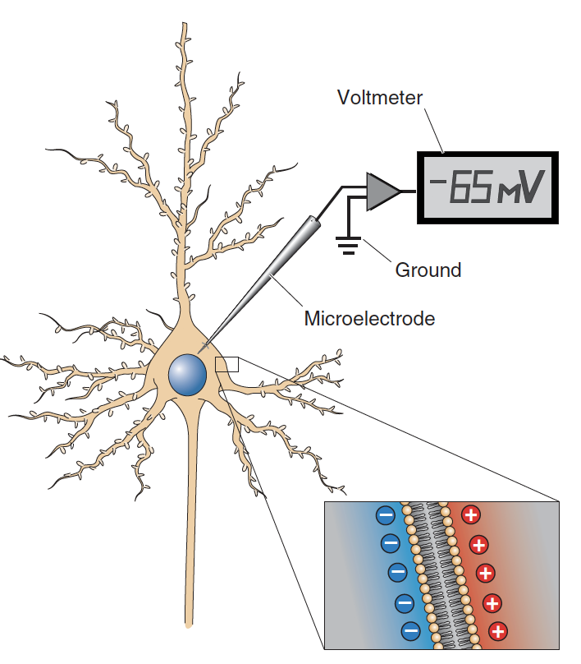
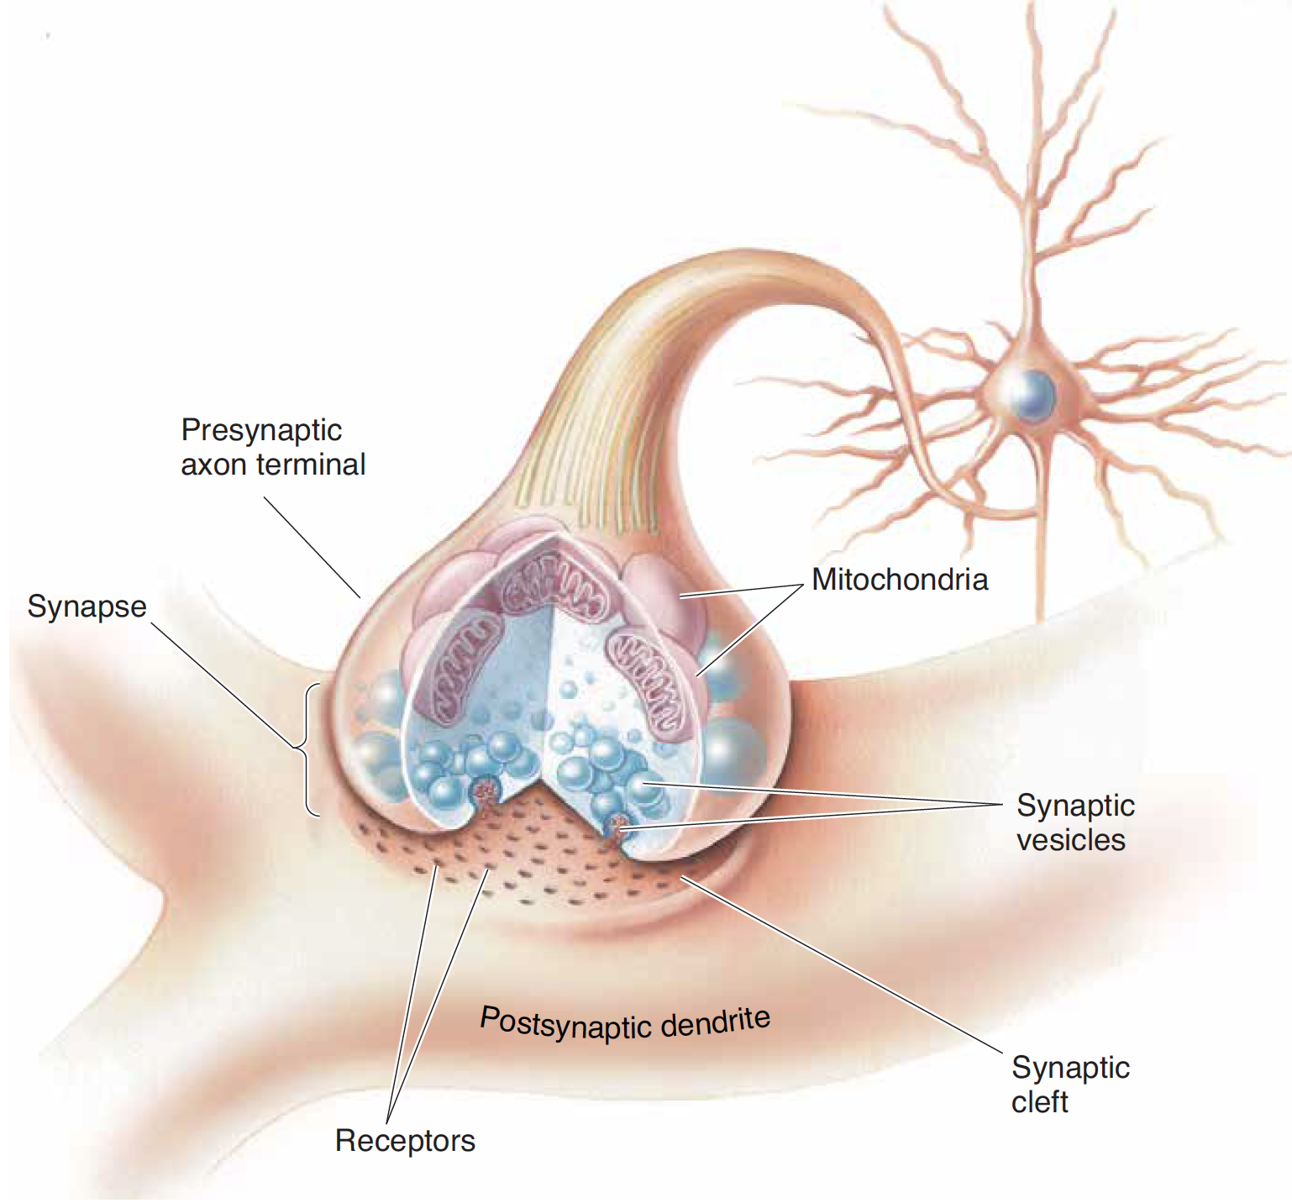
Neural Signals
Prof. Dr. Julian Keil | keil@psychologie.uni-kiel.de | www.biopsych.uni-kiel.de

Slide 11
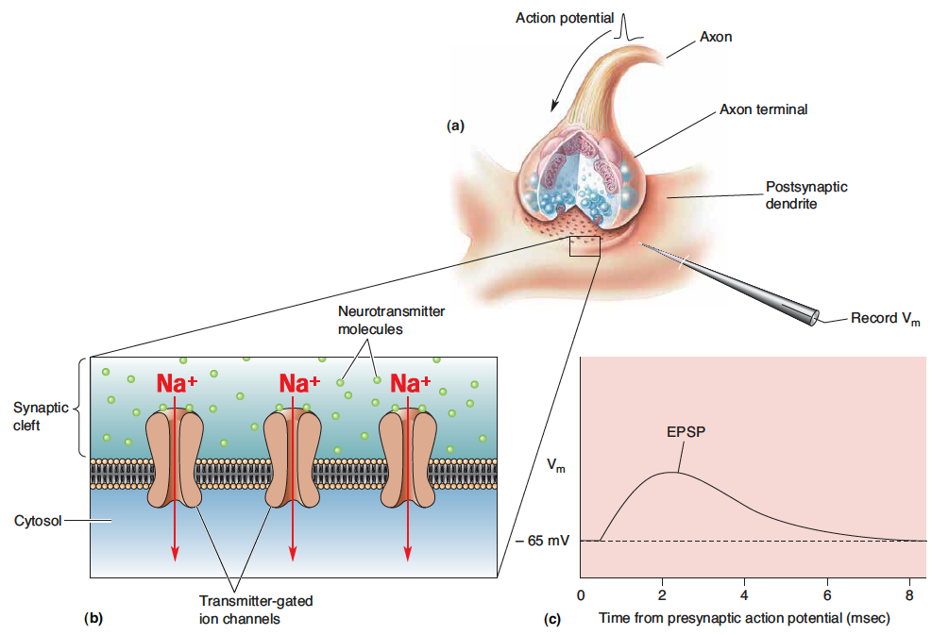
Neural Signals
Prof. Dr. Julian Keil | keil@psychologie.uni-kiel.de | www.biopsych.uni-kiel.de

Slide 12
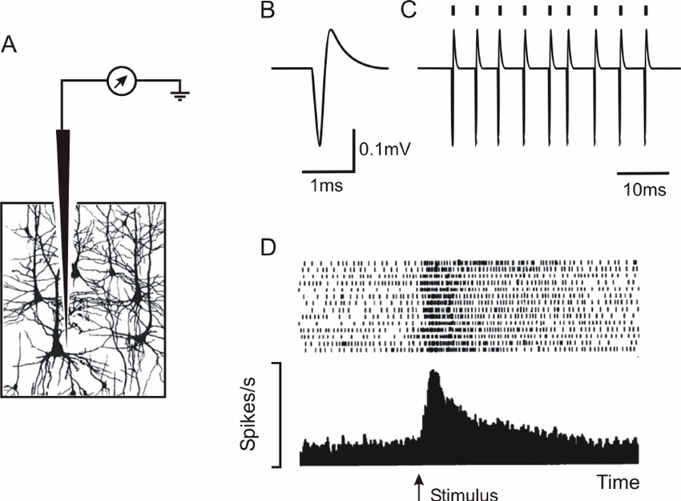
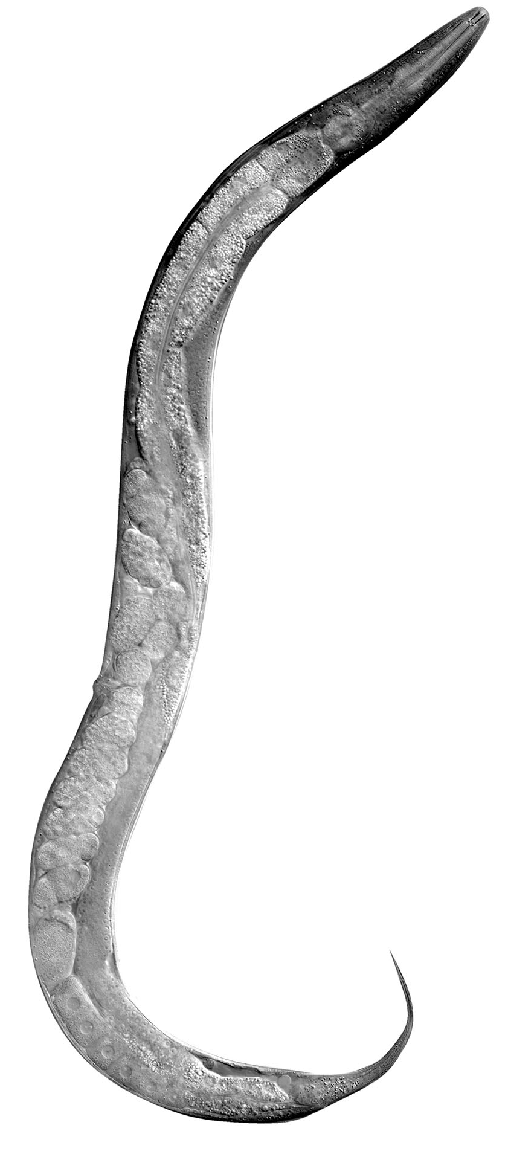
Single cell recordings
Prof. Dr. Julian Keil | keil@psychologie.uni-kiel.de | www.biopsych.uni-kiel.de
Notes:
C. Elegans
One way to record data is by using small electrodes that record electrical activity close to the neurons. Similar to looking at one single audience member and recording the clapping, we‘re recording the firing activity of single neurons here.
This is rather invasive and takes quite some time to find a responsive neuron.

Slide 13
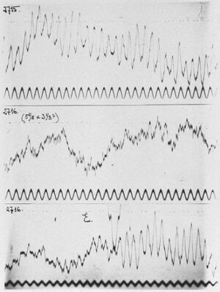
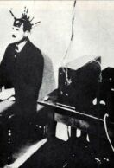
Scalp recordings: History
Berger, 1929
Prof. Dr. Julian Keil | keil@psychologie.uni-kiel.de | www.biopsych.uni-kiel.de
Notes:
Another option is to record electrical activity outside the head.
Invented in 1929 by Hans Berger in Jena– actually wanted to record telekinesis.

Slide 14
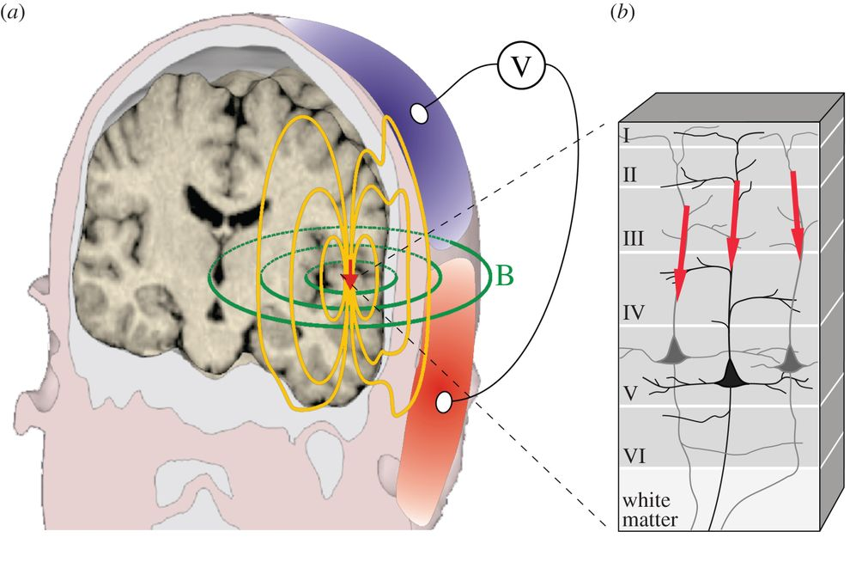
Electrophysiology
Prof. Dr. Julian Keil | keil@psychologie.uni-kiel.de | www.biopsych.uni-kiel.de
Notes:
Record postsynaptic potentials in the dendrites of parallel pyramidal neurons -> Summed activity of large neuronal patches
Downside: We can‘t record single neurons
Upside: Not invasive, cheap, fast
V = EEG: Voltage difference -> needs a reference
B = MEG: Magnetic field -> doesn‘t need a reference. Magnetic field is orthogonal to the electric field
Advantage MEG: No influence due to Skull and CSF. Disadvantage: Expensive (needs Helium to cool).

Slide 15
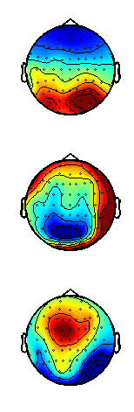
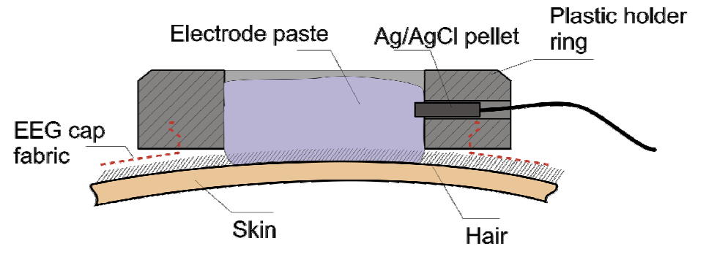
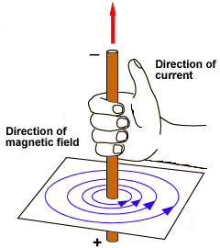
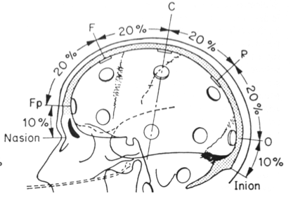
Electrophysiology
Prof. Dr. Julian Keil | keil@psychologie.uni-kiel.de | www.biopsych.uni-kiel.de
Notes:
Physical Current flow: Right Hand Rule. From Positive to negative (Primary Current).
Electrical Field: Negative to Positive (Secondaty Current)
In EEG, we record the electrical field outside the head.
From the topography, we can infer the sources of the activity

Slide 16
Interim Summary: How is information transported and how can we record it?
Neurons communicate by electrical signals
Electrical signals encode information
Summed electrical signals at the dendrites can be recorded through EEG
Rhythmic changes in local activity
Prof. Dr. Julian Keil | keil@psychologie.uni-kiel.de | www.biopsych.uni-kiel.de

Slide 17
Neural Oscillations
Prof. Dr. Julian Keil | keil@psychologie.uni-kiel.de | www.biopsych.uni-kiel.de
Notes:
Different aspects of neural oscillations
ERP: Phase always similar, only amplitude varies
Time-Frequency Analysis: All aspects can vary

Slide 18
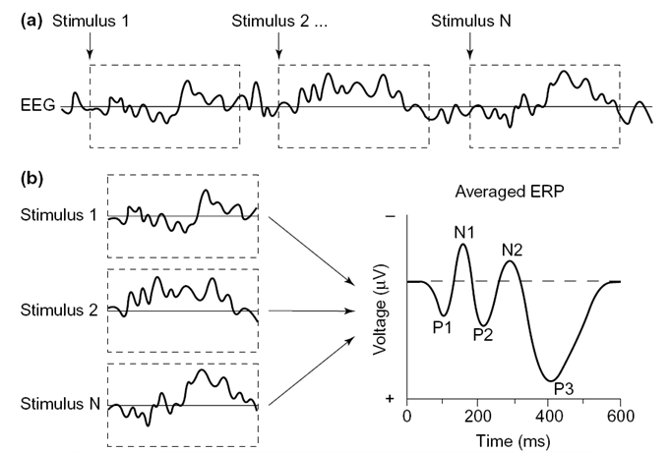
Neural Oscillations: Evoked Potentials
Prof. Dr. Julian Keil | keil@psychologie.uni-kiel.de | www.biopsych.uni-kiel.de
Notes:
In cognitive Neurscience, we not only record the ongoing signal, but we also record the signal to repeated presentations of the same stimulus.
Then we can average the single responses, so see what is common after each presentation.
This gives us the so called „ERP“
Polarity is not important! Depends on the Reference!

Slide 19

Experiment: Processing Speed
Menti.com
5709 7797
Prof. Dr. Julian Keil | keil@psychologie.uni-kiel.de | www.biopsych.uni-kiel.de
Notes:
Different aspects of neural oscillations
ERP: Phase always similar, only amplitude varies
Time-Frequency Analysis: All aspects can vary

Slide 20
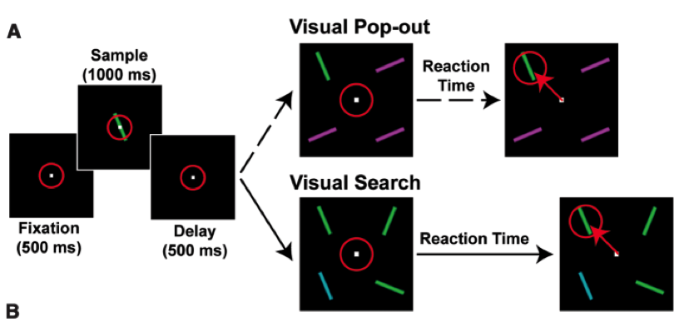
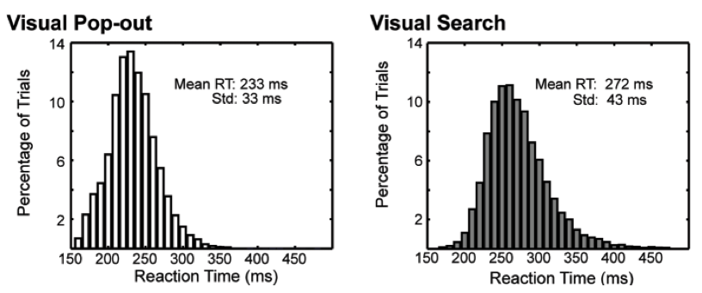
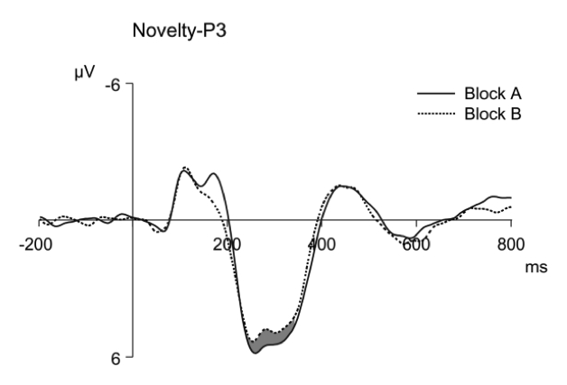
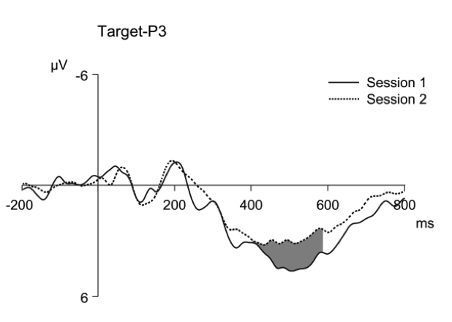
Visual Perception
Prof. Dr. Julian Keil | keil@psychologie.uni-kiel.de | www.biopsych.uni-kiel.de
Notes:
How is EEG used in cognitive Neuroscience?
Example: Visual Search.
2 Strategies: Pop-Out -> Salient Stimuli -> Fast
Search -> Difficult Stimuli -> Slow

Slide 21
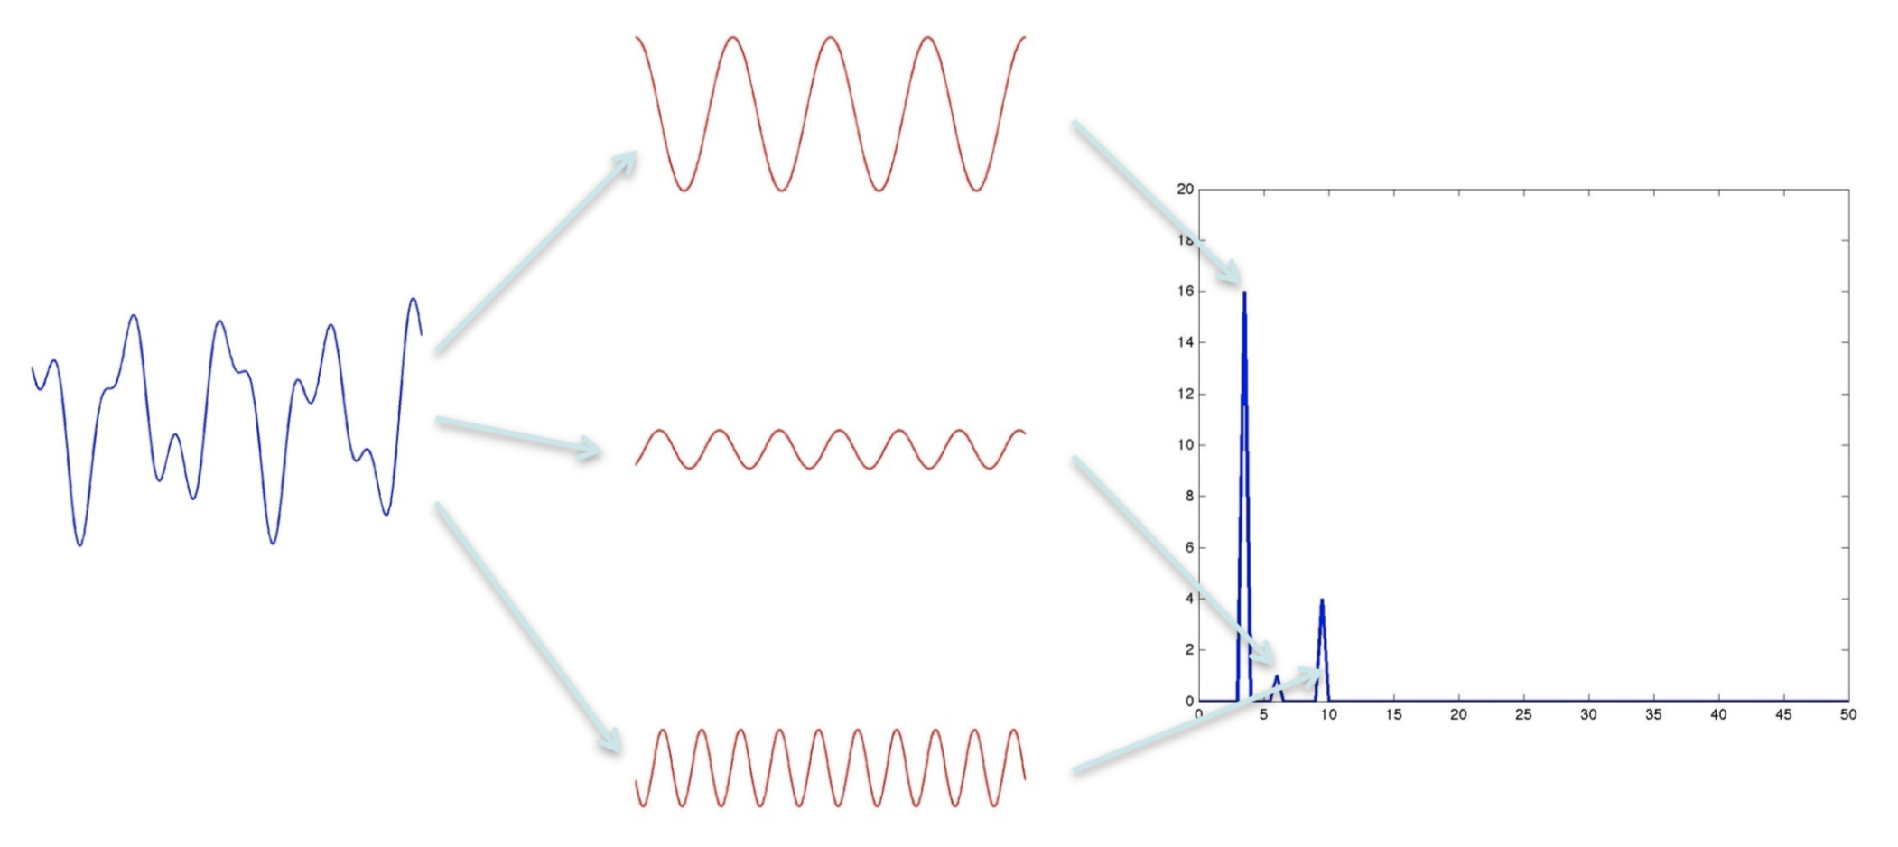
Fourier Analysis
Prof. Dr. Julian Keil | keil@psychologie.uni-kiel.de | www.biopsych.uni-kiel.de
Notes:
Complex waveform in the M/EEG is composed of multiple sine-waves. We can use FFT to tease apart the different parts of an oscillations to see how much power each frequency has and at what phase a stimulus arrives.

Slide 22
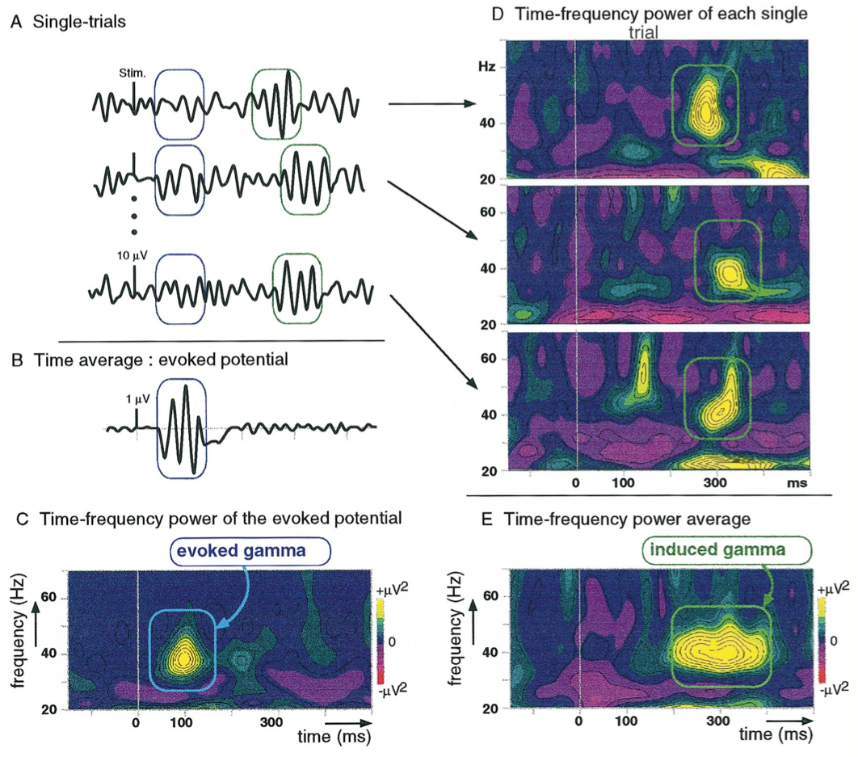
Neural Oscillations
Prof. Dr. Julian Keil | keil@psychologie.uni-kiel.de | www.biopsych.uni-kiel.de
Notes:
Problem for ERP analysis: What happens if signal is not temporally stable -> Averaging will erase the signal.
How can we analyze the signal in further detail: Oscillations –> Contain different Frequencies
Solution: Look at Oscillations
2 Different types of oscillations: Evoked and Induced
Evoked is similar to ERP. Induced is not locked in time. Induced more relevant for cognitive and perceptual processes.
Entweder kann man durch eine einfache Fourier-Transformation die Zeitreiheninformation in eine Frequenzdarstellung übertragen (geht nur, da Schwingungen kontinierlich sind, bzw. unter dieser Annahme) oder in eine Zeit-Frequenz-Darestellung übertragen, in der der Zeitverlauf jeder Frequenz dargestellt ist.
Hier sieht man jetzt auch schon, dass es 2 Arten Oszillatorischer Aktivität gibt: induziert und evoziert.

Slide 23
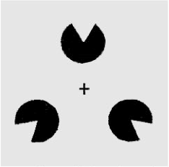
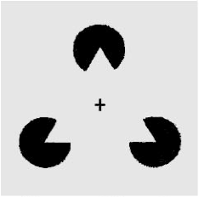
Visual Perception
Prof. Dr. Julian Keil | keil@psychologie.uni-kiel.de | www.biopsych.uni-kiel.de
Notes:
Example from cognitive Neuroscience on the role of oscillations

Slide 24
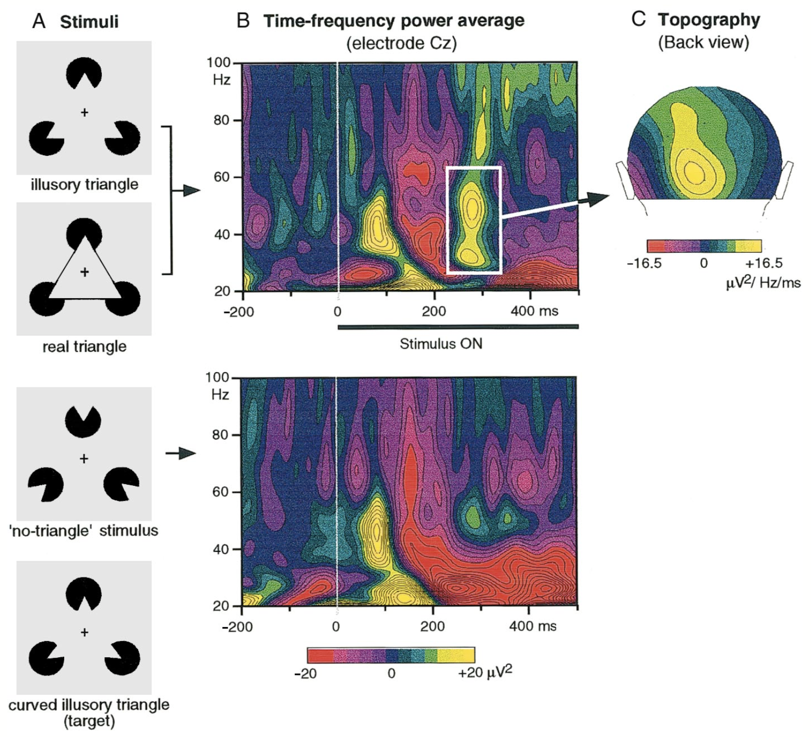
Neural Oscillations: Induced Potentials
Prof. Dr. Julian Keil | keil@psychologie.uni-kiel.de | www.biopsych.uni-kiel.de
Notes:
First: Evoked Gamma -> Stimulus arrives in the visual cortex.
Second: Induced Gamma -> Only if Stimulus is bound to a coherent percept

Slide 25
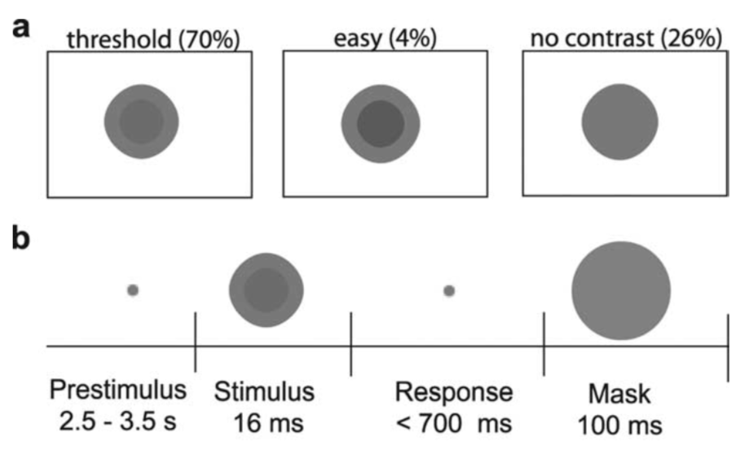
Visual Detection
Prof. Dr. Julian Keil | keil@psychologie.uni-kiel.de | www.biopsych.uni-kiel.de
Notes:
Perception is not fixed, but varies over time.
No only use salient stimuli, but also look at how oscillations influence perception of weak stimuli.

Slide 26
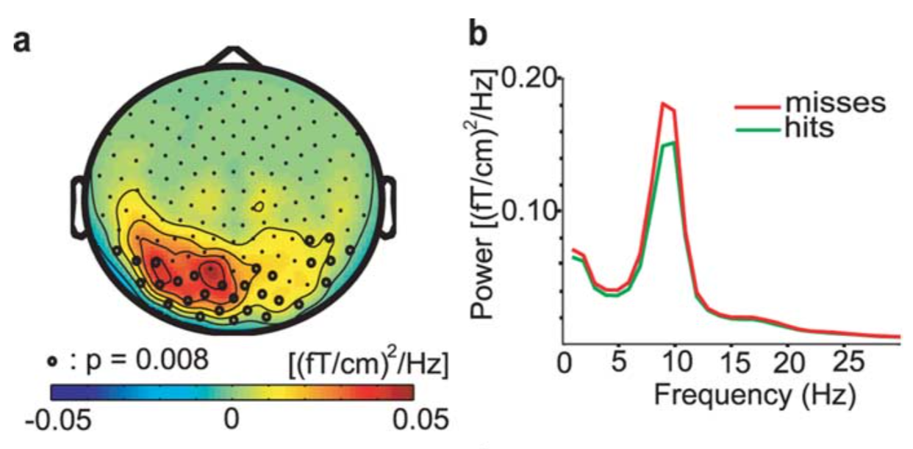
Influences on visual perception
Prof. Dr. Julian Keil | keil@psychologie.uni-kiel.de | www.biopsych.uni-kiel.de
Notes:
Neural oscillations different BEFORE stimulus onset.
Alpha band (10 Hz) Power prior to stimulus onset influences perception. Low Alpha -> Higher Perception rate
Alpha power indexes excitability.

Slide 27
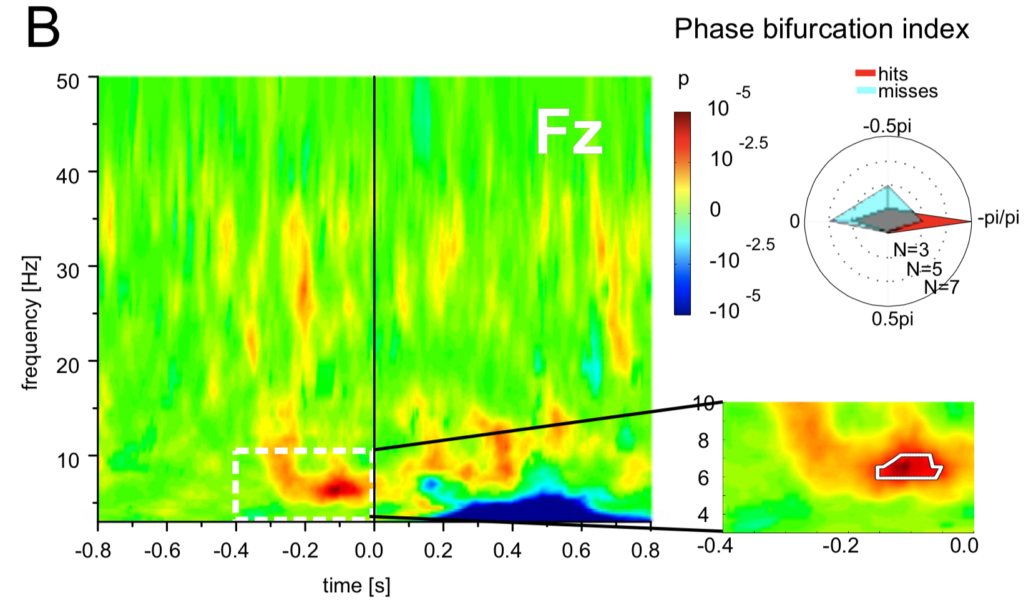
Influences on visual perception
Notes:
Not only alpha band power, but also alpha phase important for perception.
Depending on the phase at which a stimulus arrives, it will be further processed or not.
Important: Here frontal electrode.

Slide 28
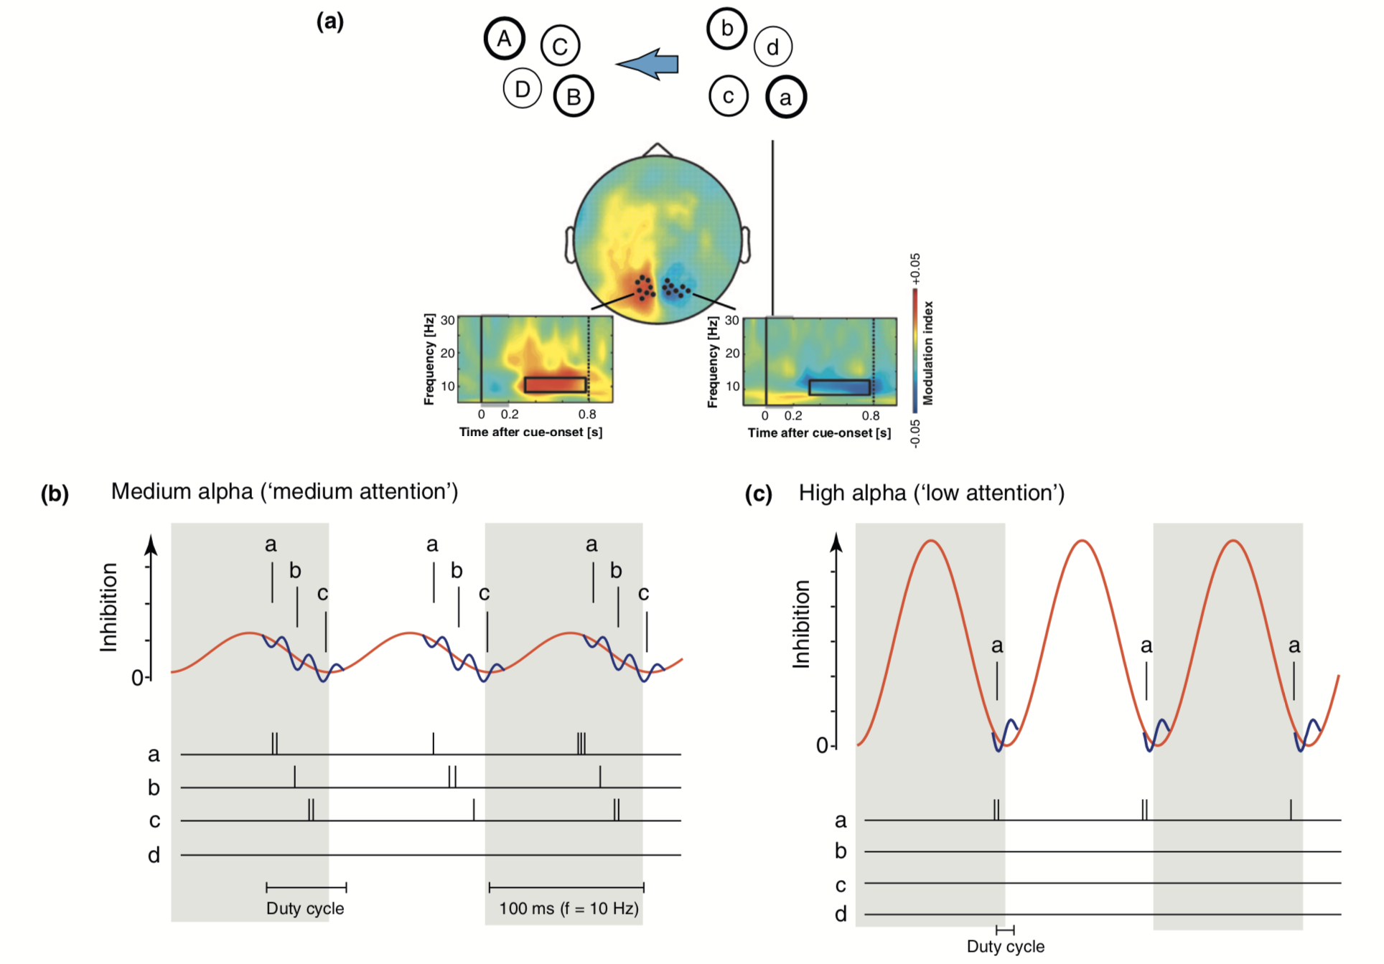
Influences on visual perception: Attention
Notes:
Question: Is visual perception continuous or does it occur in single images?
What happens if I focus on one part of an image?
How are single elements bound together?
In visual perception, alpha oscillations can act as a mechanism to organize our perception.
Stimuki themseleves evoke gamma band oscillations (single bars).
Visual Perception is organized in single images and alpha band defines the frequency of the single images. High alpha band power inhibits activity, and the phase groups single items either to a coherent percept or to separate events.

Slide 29
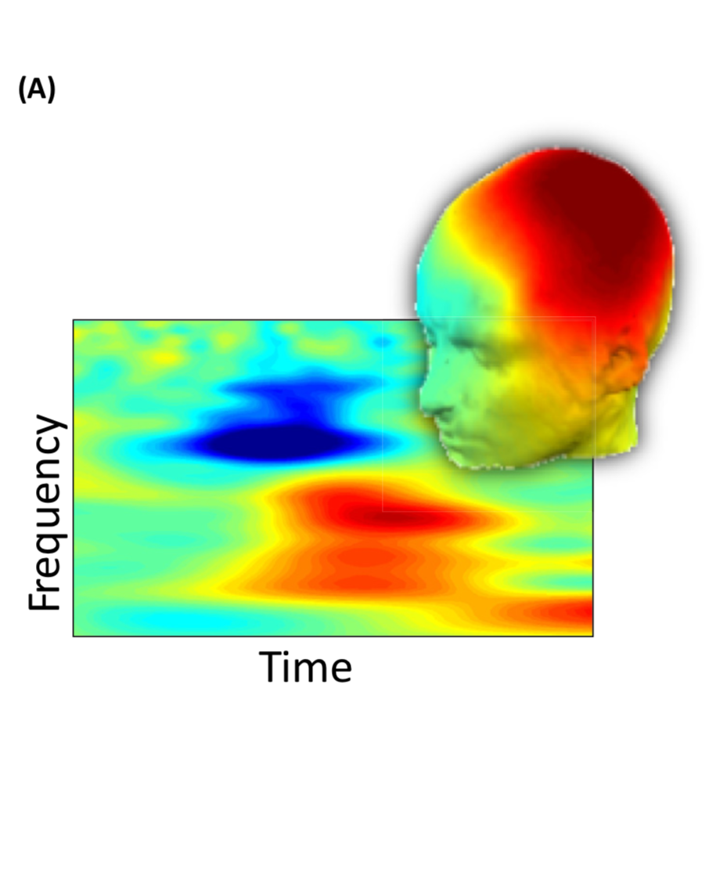
Summary: Role of neural oscillations for cognition
Changes in summed postsynaptic potentials encode stimulus processing and cognitive processes
ERPs are summed fixed-latency (same phase) signals
Time-frequency analysis can recover time-varying amplitude changes
Changes in neural activity influence perception and cognition
Prof. Dr. Julian Keil | keil@psychologie.uni-kiel.de | www.biopsych.uni-kiel.de
Notes:
Multiple Rhythms are active at the same time.
Higher-order theta-rhythm (7 Hz) guides attention, 10 Hz alpha rhythm samples perception, 20 Hz Beta rhythm binds different cortical areas together.

Slide 30
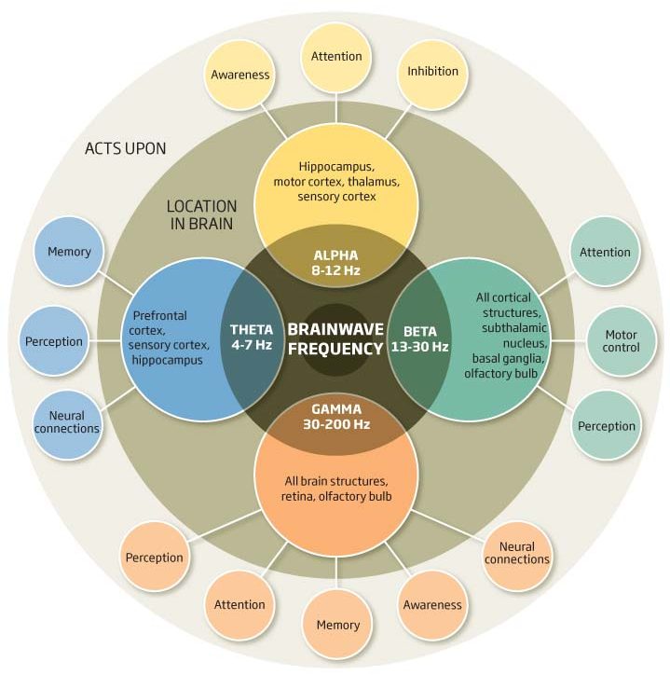
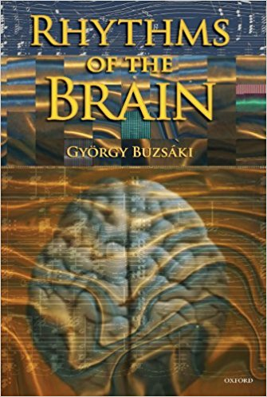
Summary
Prof. Dr. Julian Keil | keil@psychologie.uni-kiel.de | www.biopsych.uni-kiel.de
Notes:
Multiple Rhythms are active at the same time.
Higher-order theta-rhythm (7 Hz) guides attention, 10 Hz alpha rhythm samples perception, 20 Hz Beta rhythm binds different cortical areas together.

Slide 31
Let‘s get to work!
Today:
Record ERP
Resting State Data
Tomorrow
Analyze Data
Documentation
Prof. Dr. Julian Keil | keil@psychologie.uni-kiel.de | www.biopsych.uni-kiel.de
Notes:
Multiple Rhythms are active at the same time.
Higher-order theta-rhythm (7 Hz) guides attention, 10 Hz alpha rhythm samples perception, 20 Hz Beta rhythm binds different cortical areas together.

Slide 32
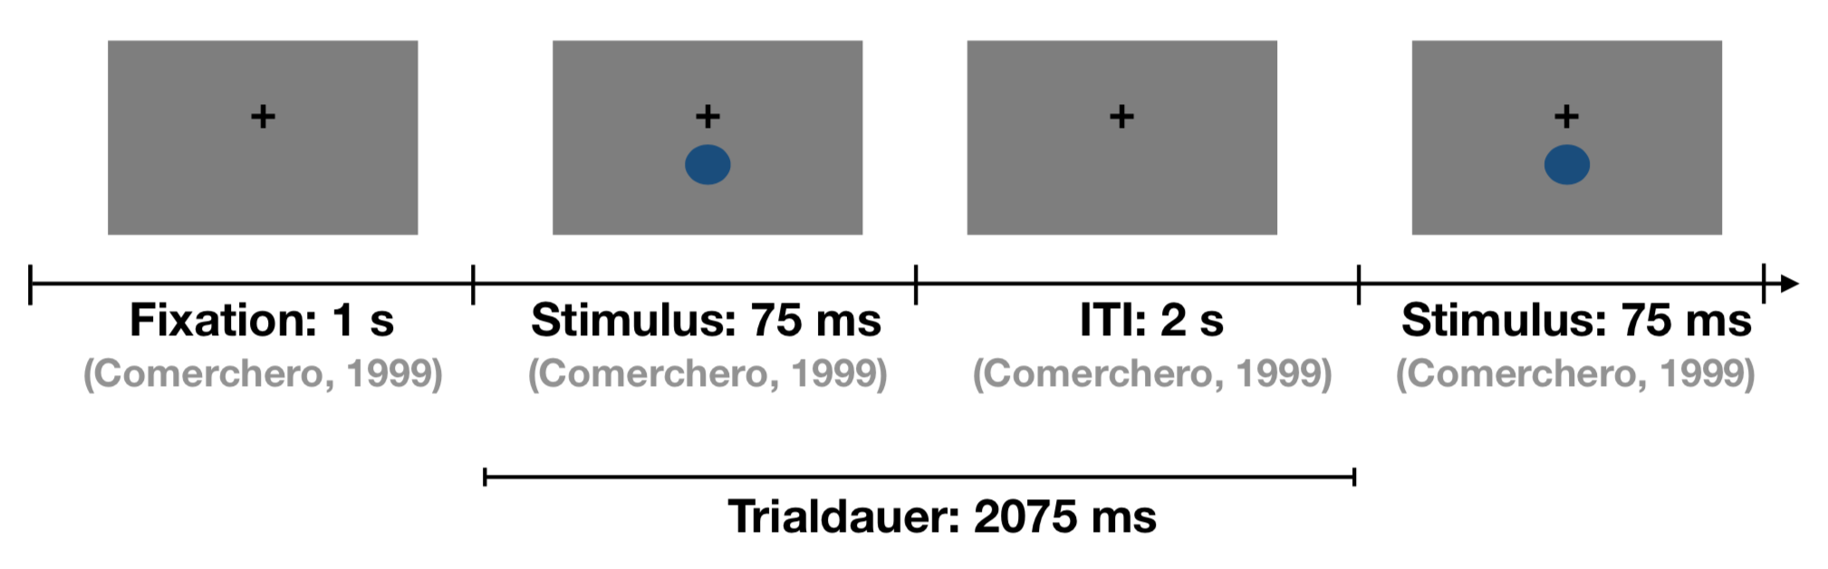
P3 Experiment
Colored Stimuli
75 ms duration?
Attention: Use multiples of the screen refresh rate 1000/60:
1: 16.66667 2: 33.33333 3: 50.00000 4: 66.66667 5: 83.33333
1.5 – 2.5 s random ITI

Slide 33
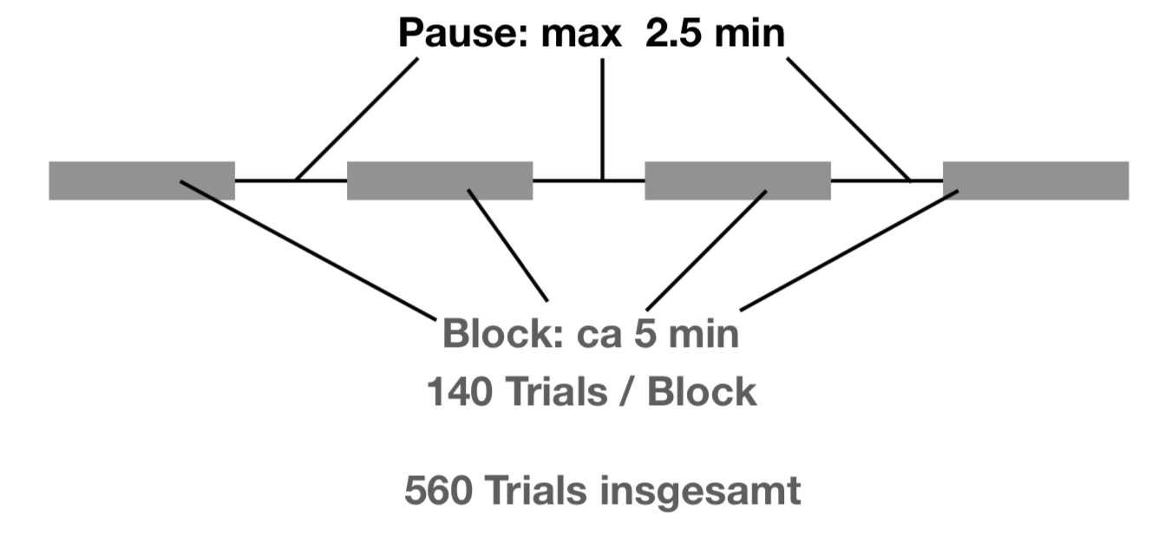
P3 Experiment
Trial:
66 ms Stim + 2 s ITI
2066 ms
Block:
14 Targets (10%)?
126 Standard (90%))
140 Trials -> 4.82 minutes
Task: count targets
Important: change color
Experiment:
5 minutes resting state
4 blocks -> 560 trials total
Notes:
Obacht: 14 Targets * 4 = 56 Trials: 10% Ausschuss ist dann schon am unteren Rand der Trialzahl
21 Targets wären 15% -> 84 Trials
119 Standards wären 85%
28 Targets wären 20% -> Einfacher auf Trial-Struktur anzuwenden (Verhältnis 1:5)
Ziel: Klare Teiler finden!
Option 1: Blöcke Bauen
Option 2: Alle trials bauen, dann in 4 Blöcke teilen!

Slide 34
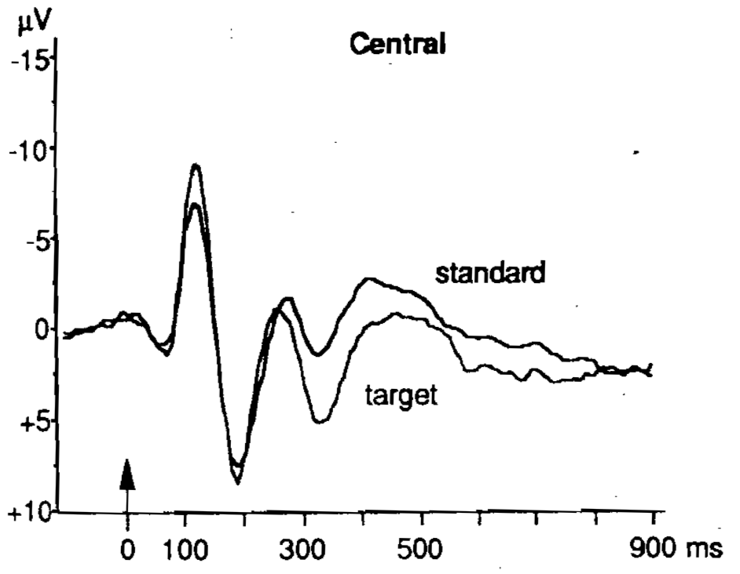
P3 Analysis
Positive wave after 300 ms post target
Compare to standard!
Index of
Attention
Working Memory
Cognitive Control
Subcomponents
P3a: Surprise
P3b: Oddball
Prof. Dr. Julian Keil | keil@psychologie.uni-kiel.de | www.biopsych.uni-kiel.de
Notes:
Multiple Rhythms are active at the same time.
Higher-order theta-rhythm (7 Hz) guides attention, 10 Hz alpha rhythm samples perception, 20 Hz Beta rhythm binds different cortical areas together.

Slide 35
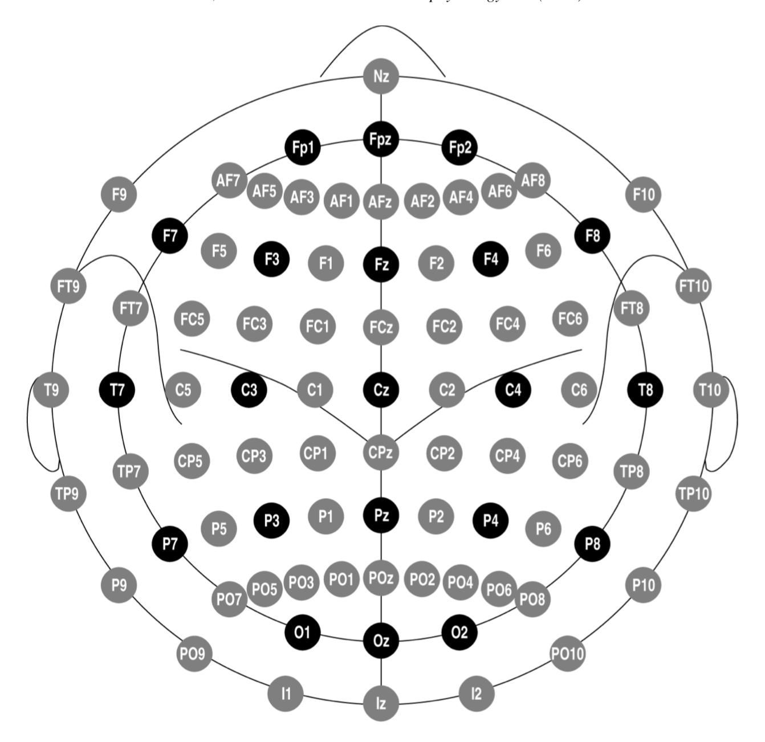
P3 Analysis
Where to record the P3?
EEG at Fz, Cz und Pz
30 Hz Lowpass Filter
100 ms Baseline
How to extract the P3?
Max. Amplitude 250-400 ms
How to test the P3?
Amplitude and Latency
Standard
Go-Target

Slide 36
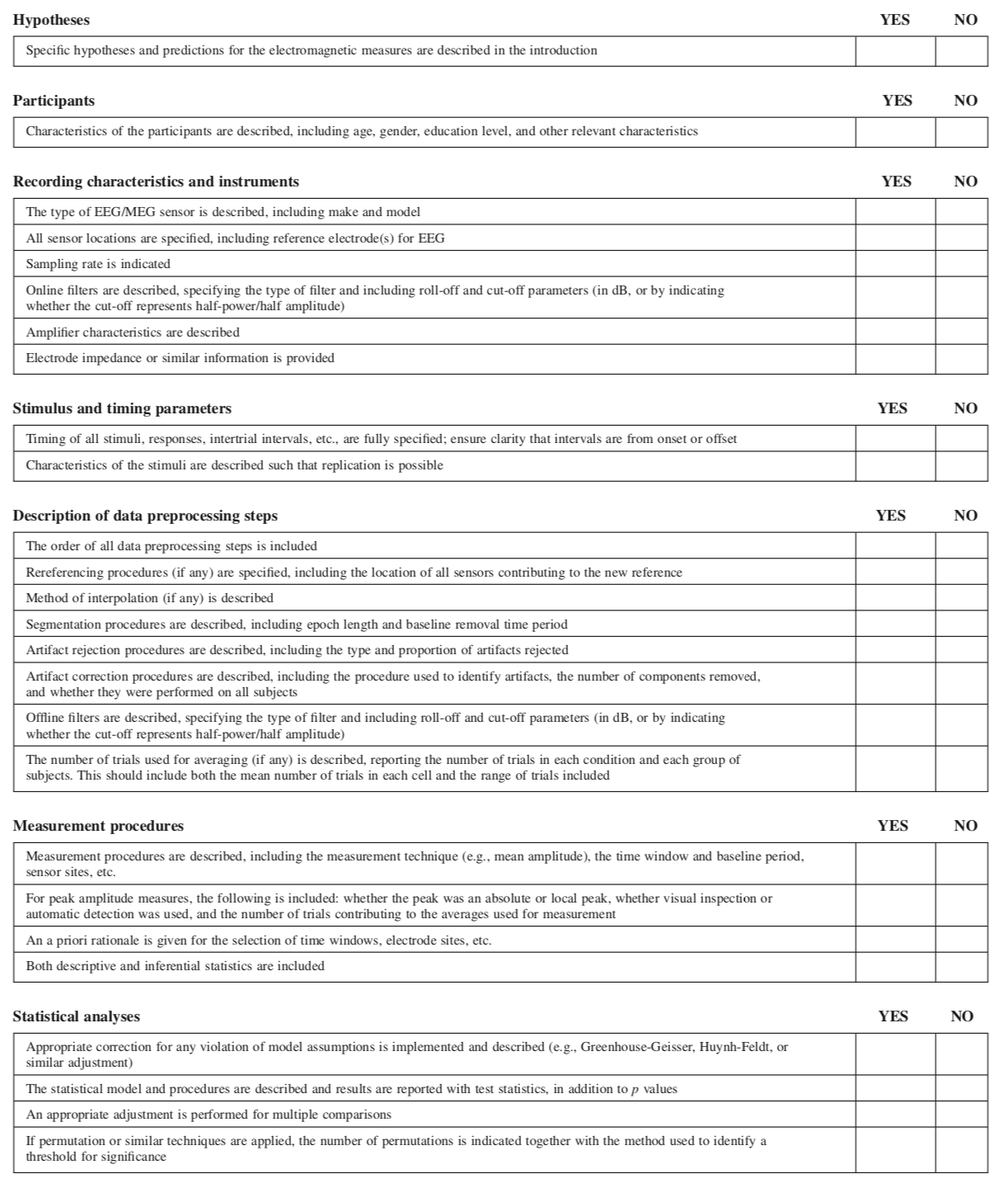
Authors‘ Checklist

Slide 37
Authors‘ Checklist

Slide 38
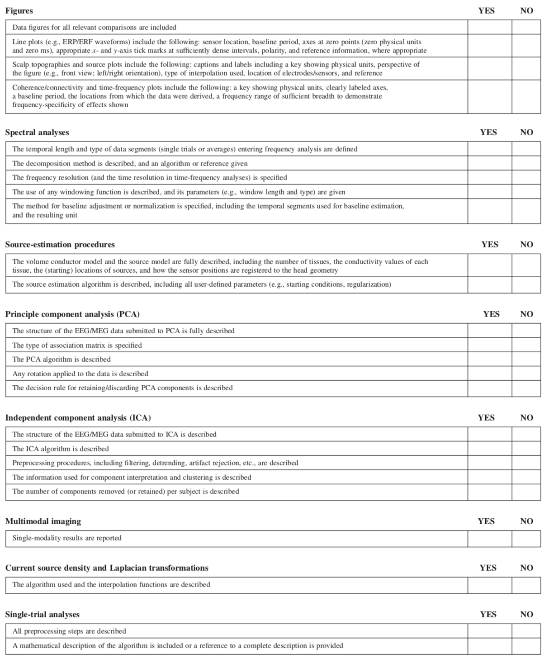
Authors‘ Checklist

Slide 39
Authors‘ Checklist

Slide 40
References
Cohen, M. X. (2017). Where Does EEG Come Fromand What Does It Mean? TRENDS in Neurosciences, 40(4), 208–218.
Berger, H. (1929). Über das Elektroenkephalogramm des Menschen. Arch Psychiatr Nervenkrankh, 87, 527–570.
Kandel, E., 2012. Principles of Neural Science, 5th Ed.
Buzsáki, G., 2011. Rhythms of the Brain
Buzsáki, G., & Draguhn, A. (2004). Neuronal oscillations in cortical networks. Science, 304(5679), 1926–1929.
Luck, S., 2014. An Introduction to the Event-Related Technique, 2nd Ed.
Debener, S., Kranczioch, C., Herrmann, C. S., & Engel, A. K. (2002). Auditory novelty oddball allows reliable distinction of top-down and bottom-up processes of attention. International Journal of Psychophysiology, 46(1), 77–84.
Tallon-Baudry, C., & Bertrand, O. (1999). Oscillatory gamma activity in humans and its role in object representation. Trends in Cognitive Sciences, 3(4), 151–162.
Van Dijk, H., Schoffelen, J.-M., Oostenveld, R., & Jensen, O. (2008). Prestimulus Oscillatory Activity in the Alpha Band Predicts Visual Discrimination Ability, Journal of Neuroscience, 28(8), 1816–1823.

Slide 41
References
Busch, N. A., Dubois, J., & Vanrullen, R. (2009). The phase of ongoing EEG oscillations predicts visual perception. The Journal of Neuroscience, 29(24), 7869–7876.
Jensen, O., Bonnefond, M., & Vanrullen, R. (2012). An oscillatory mechanism for prioritizing salient unattended stimuli. Trends in Cognitive Sciences, 16(4), 200–206.
Thomson, H. (2010). Decoding the brain beat. New Scientist, 2768, 1–4. http://doi.org/https://doi.org/10.1016/S0262-4079(10)61684-3
Keil, A., Debener, S., Gratton, G., Junghöfer, M., Kappenman, E. S., Luck, S. J., et al. (2014, January). Committee report: publication guidelines and recommendations for studies using electroencephalography and magnetoencephalography. Psychophysiology. http://doi.org/10.1111/psyp.12147
Comerchero, M. D., & Polich, J. (1999). P3a and P3b from typical auditory and visual stimuli. Clinical Neurophysiology : Official Journal of the International Federation of Clinical Neurophysiology, 110(1), 24–30.
Rockstroh, B., Müller, M., Cohen, R., & Elbert, T. (1992). Probing the functional brain state during P300-evocation. Journal of Psychophysiology, 6, 175–175.

